Slide 1


SMART INDIA HACKATHON 2025
TITLE PAGE
Problem Statement ID: 25236
Problem Statement Title: Application software to obfuscate the object file using Low Level Virtual Machine (LLVM)
Theme: Blockchain & Cybersecurity
PS Category: Software
Team ID: 56745
Team Name: GENOMIKS

Slide 2
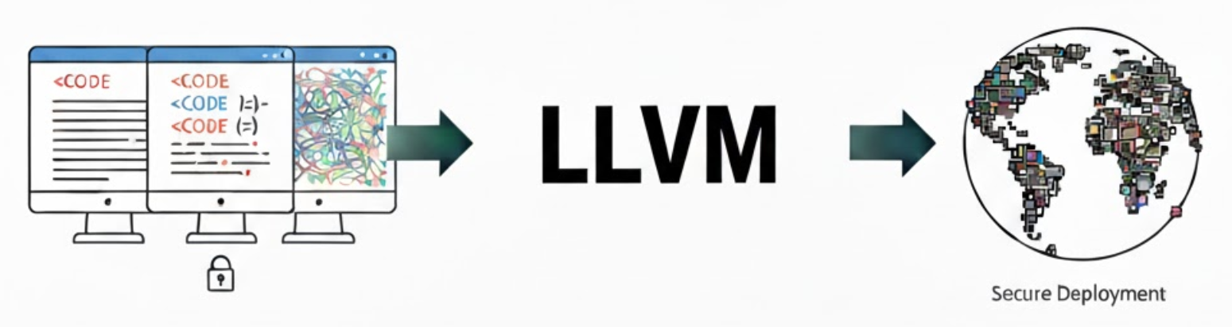
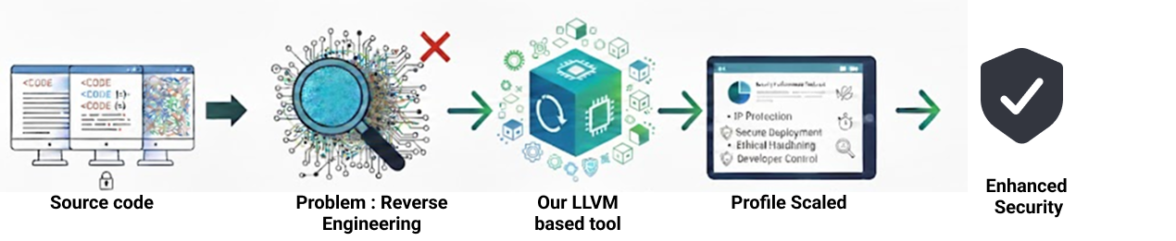

APPLICATION SOFTWARE TO OBFUSCATE THE OBJECT FILE USING LOW LEVEL VIRTUAL MACHINE (LLVM)
GENOMIKS
Our Idea:
Our Proposed Solution
Our idea is to create an LLVM-based software obfuscation tool that protects object files and executables from reverse engineering without compromising performance.
1. Comprehensive Obfuscation: We offer a tool that applies transformations like string encryption and control-flow flattening at the LLVM IR level to protect code.
2. Customized and Optimized Protection: The tool uses profile-guided obfuscation to target critical code, and its configurable pipeline allows you to balance security and performance.
How its Innovative?
It introduces adaptive LLVM passes, a debug-friendly reversible mode, and quantitative resilience metrics for a transparent and ethical approach to code security.

Slide 3
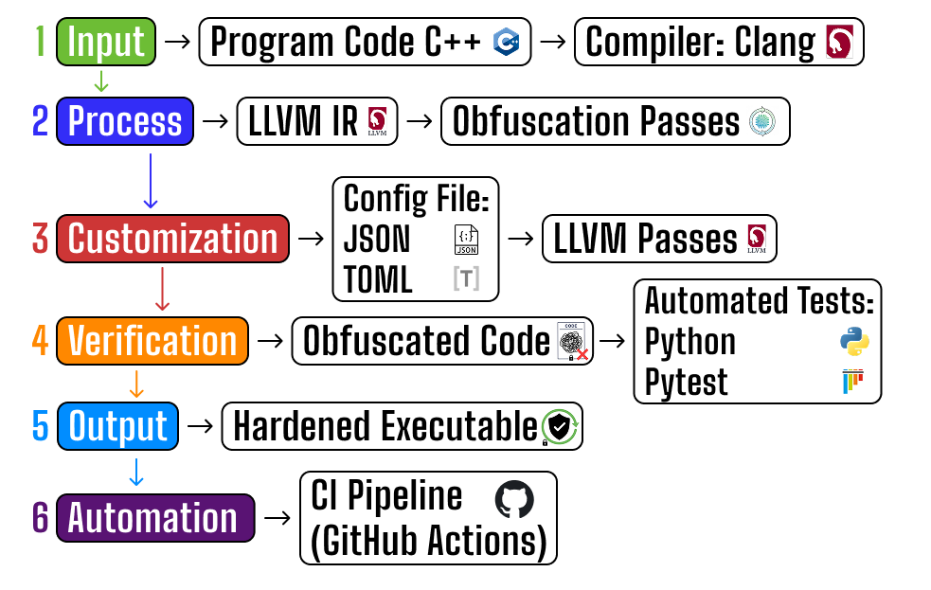
TECHNICAL APPROACH
GENOMIKS
Methodology & Required Technologies
Steps
Input: A developer's program code (e.g., C++) is compiled using a standard compiler.
Transformation: The compiled code is sent to our tool. Our tool, powered by LLVM, applies a series of obfuscation techniques.
Customization: The developer can use a configuration file (JSON/TOML) to choose which obfuscation techniques to use. This allows them to balance security with performance.
Verification: The tool then automatically checks if the obfuscated code still works correctly.
Output: A secure, hardened executable is produced, ready for deployment.
Continuous Integration (CI): The entire process can be automated within a CI pipeline (GitHub Actions), ensuring every new code change is protected.

Slide 4
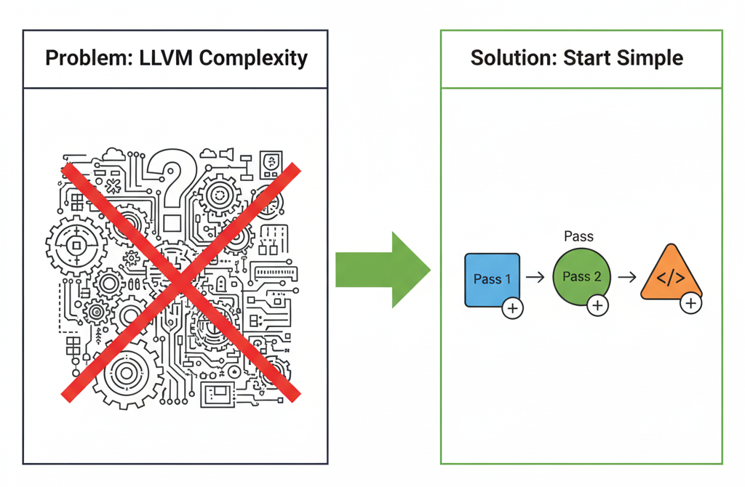
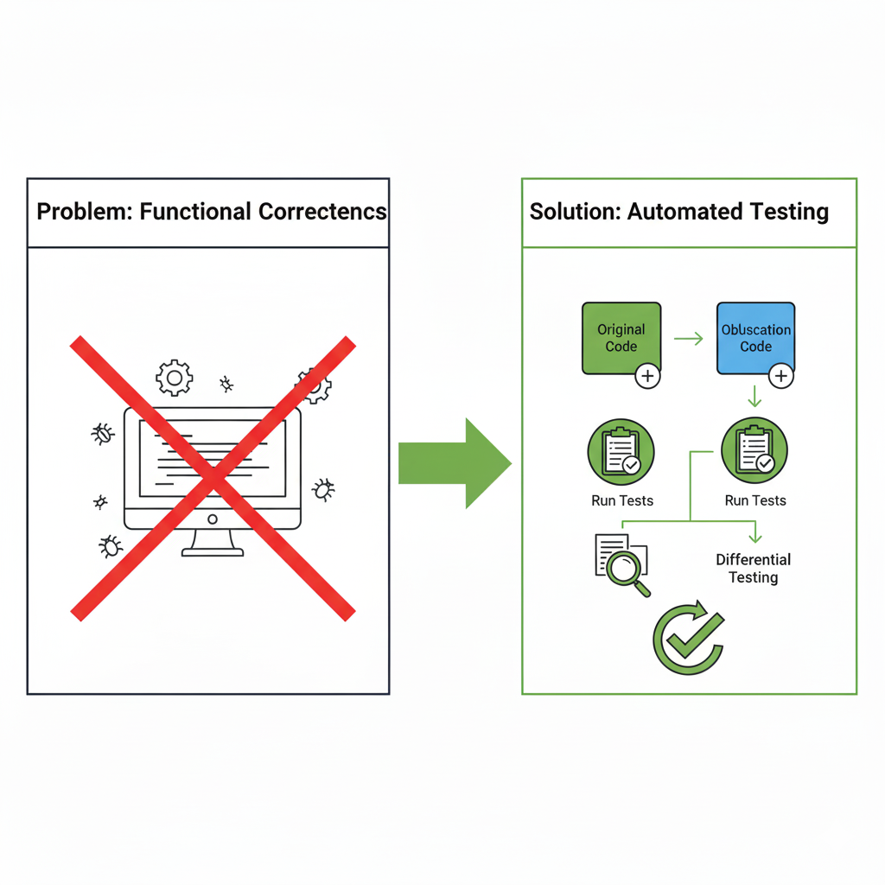
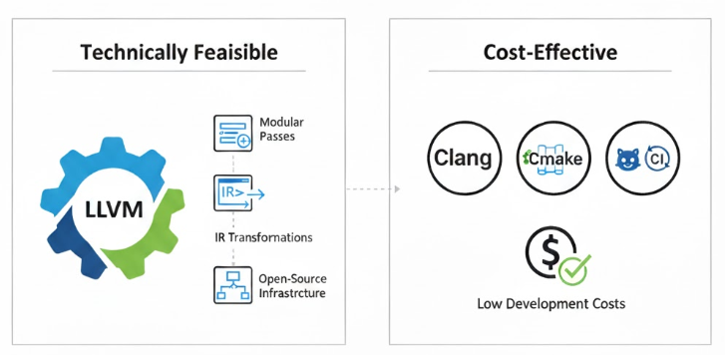
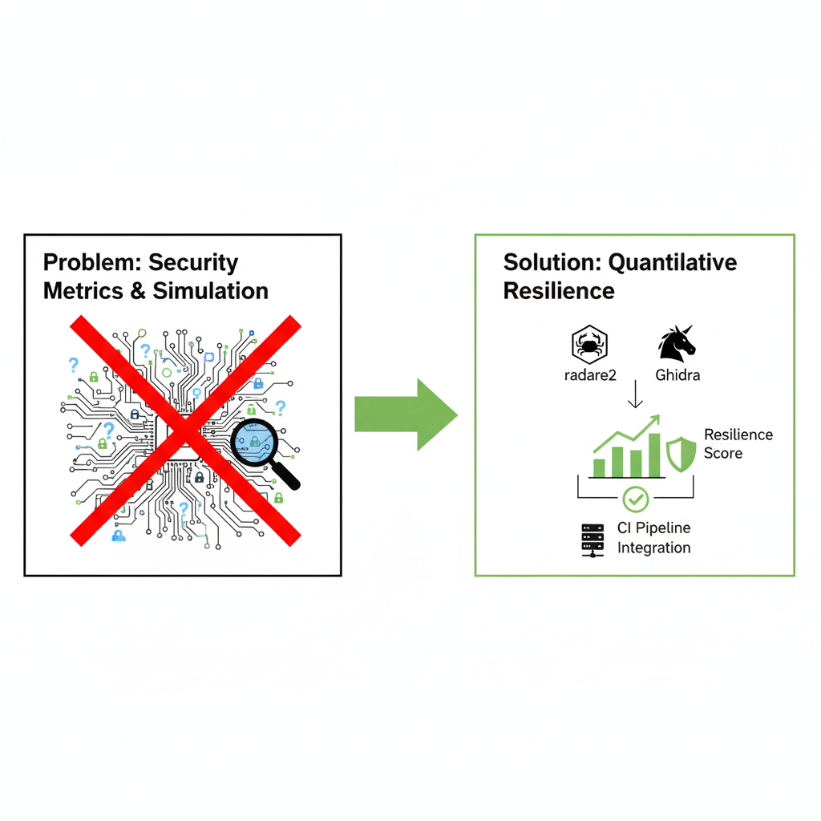
FEASIBILITY AND VIABILITY
GENOMIKS
FEASIBILITY ANALYSIS
VIABILITY ANALYSIS
Technically Feasible: The solution is built on the open-source LLVM framework, which already provides the necessary tools and modular passes for development.
Cost-Effective: It utilizes free, standard tools like Clang, CMake, and GitHub CI, keeping development costs low.
Potential Challenges and Solutions:
Problem: Complexity of LLVM internals.
Solution: Starting with simple, well-tested passes.
Problem: Maintaining functional correctness.
Solution: Integrating regression tests and differential testing to ensure correctness after obfuscation.
Problem: Security metrics & simulation. Solution: Using static-analysis tools (radare2, Ghidra) to measure decompilation difficulty and resilience scores.

Slide 5





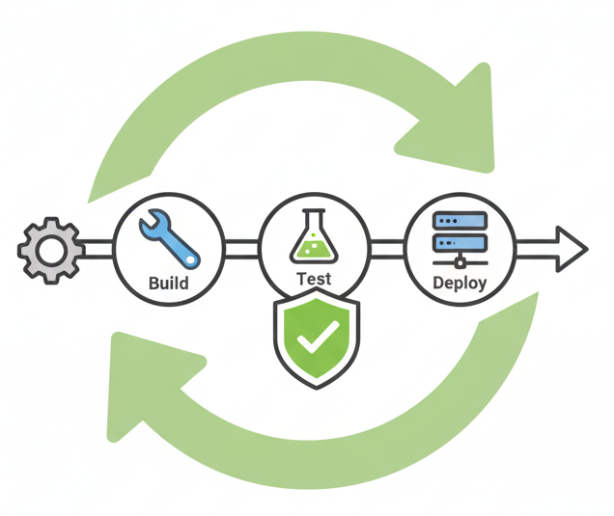

IMPACTS AND BENEFITS
GENOMIKS
IMPACTS
BENEFITS
Software Product Teams & Startups: Protects intellectual property (IP), such as proprietary algorithms, and minimizes the risk of IP theft.
Protects Innovation:
Safeguards proprietary algorithms, preserving competitive advantage and reducing plagiarism.
Economic Value:
Prevents revenue loss from piracy and cloning, and lowers the cost of security compared to expensive proprietary solutions.
Enterprise Engineering / R&D: Hardens software before distribution, enhancing security for released products.
Ethical Security: Provides an affordable, transparent tool that supports local industry and promotes ethical security practices.
DevOps / CI Teams: Integrates smoothly into existing build processes for automated and consistent security.
Sustainable & Efficient: Operates with low energy consumption on standard hardware and can reduce the need for specialized, resource-intensive anti-tamper hardware.

Slide 6
RESEARCH AND REFERENCES
GENOMIKS
Obfuscator-LLVM: https://github.com/obfuscator-llvm/obfuscator.
OLLVM: https://github.com/wwh1004/ollvm-16.
Obfuscator-pass: https://github.com/Yuerino/obfuscator-pass.

